Slide 1




Home-Streaming: Netflix, Disney+ and Prime Video Where Should I Subscribe?
Angelo G. Limone
Pasquale Formicola

Slide 2











Your Apps:
Introduction
Objectives
Data
Netflix
Amazon Prime Video
Disney+
Infographics
Netflix is a US company active in the streaming distribution of movies, television series and other paid entertainment content via the Internet. It was founded by Reed Hastings and Marc Randolph on August 29, 1997, in Scotts Valley, California.
Amazon Prime Video is a US video-on-demand service owned by the Amazon.com company. Founded by Valeria Salazar in Seattle, 7 September 2006.
Disney+ is an American subscription video-on-demand over-the-top streaming service owned and operated by the Disney Entertainment division of The Walt Disney Company. Founded in 2019.
Evaluation
Survey
Conclusions

Slide 3
Your Apps:
Introduction
Objectives
Data
Netflix
Amazon Prime Video
Disney+
Infographics
220 Millions Subscribers
175 Millions Subscribers
221 Millions Subscribers
Evaluation
17,99€ per Months
8,99€ per Months
4,99€ per Months
Survey
Conclusions

Slide 4

So, where should I Subscribe?
Introduction
Browsing the web, we realized that there is no effective method to compare the three platforms, so we asked ourselves the following question:
"How can we create a comparison method between the three platforms to provide a potential customer with all the information they need in a simple and intuitive way to subscribe to a service?".
Create simple and intuitive infographics to let the user decide which platform is most appropriate for his tastes.
Objectives
Data
Infographics
Evaluation
Survey
Conclusions

Slide 5



In order to make this possible we get 3 Datasets of Information from the three Platforms containing all informations about the Titles in their respective Catalogue (such as Release Year, Director, Nationality, Production, etc.)
Introduction
Objectives
To have further informations about the Ratings of these Titles we get the IMDB Dataset
containing all Ratings from users to that Titles.
Data
Infographics
Evaluation
In order to facilitate the work for us we merged Databases on Python obtaining one including all informations we need.
Survey
Conclusions

Slide 6


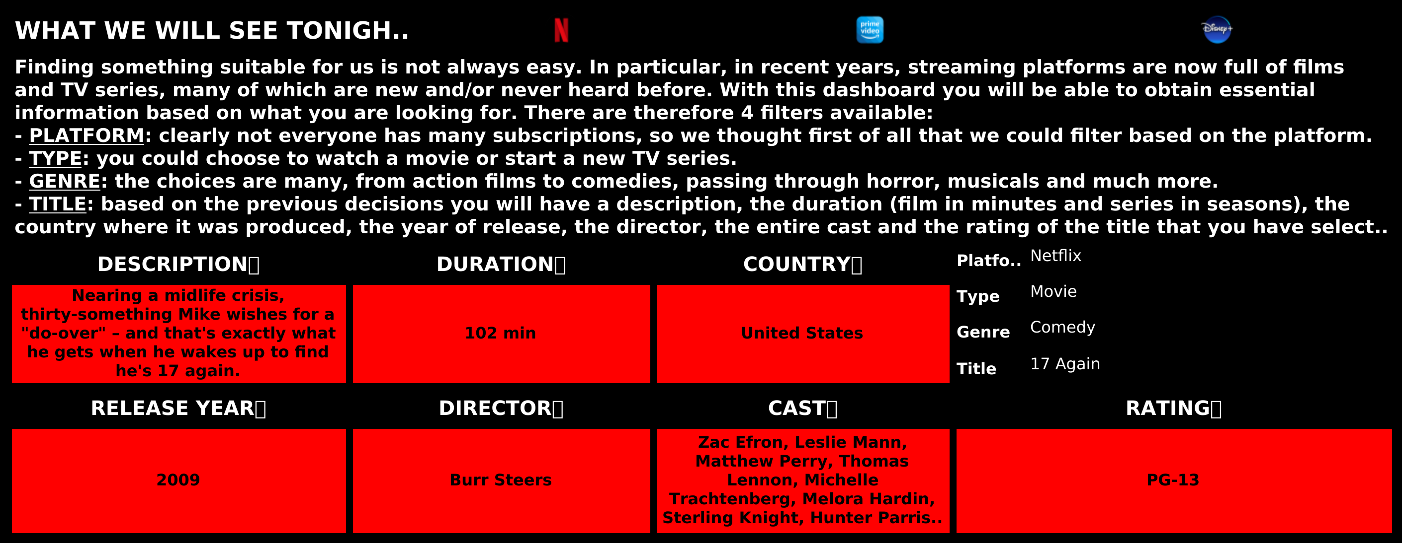

Accessable Here.
First Dashboard
The first dashboard was generated by filtering by Platform, Type, Genre and Title.
This very simple and intuitive dashboard allows the user to be able to select very specifically the main type of filters to obtain relevant titles.
The main purpose of this dashboard is first to route the user to precise titles so that he can decide which title he wants to watch, providing him with all the informations about it.
Introduction
Objectives
Data
Infographics
Evaluation
Survey
Conclusions

Slide 7
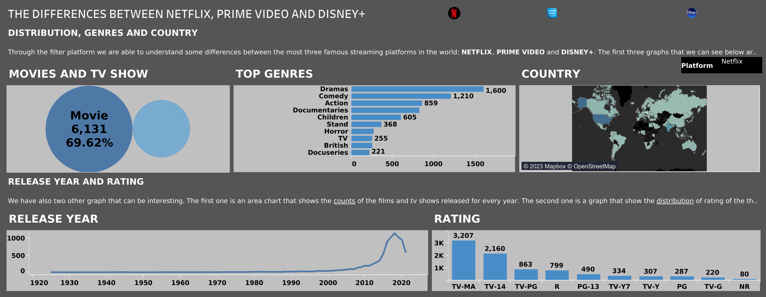
Accessable Here.
Second Dashboard
From the second dashboard, therefore, the user can understand which Home Streaming service is most suitable for him, evaluating various parameters such as: majority of Films or TV Series, Top Genres on the platform, Nationality of production of the title and year of release.
Introduction
Objectives
Data
Infographics
Evaluation
Survey
Conclusions

Slide 8
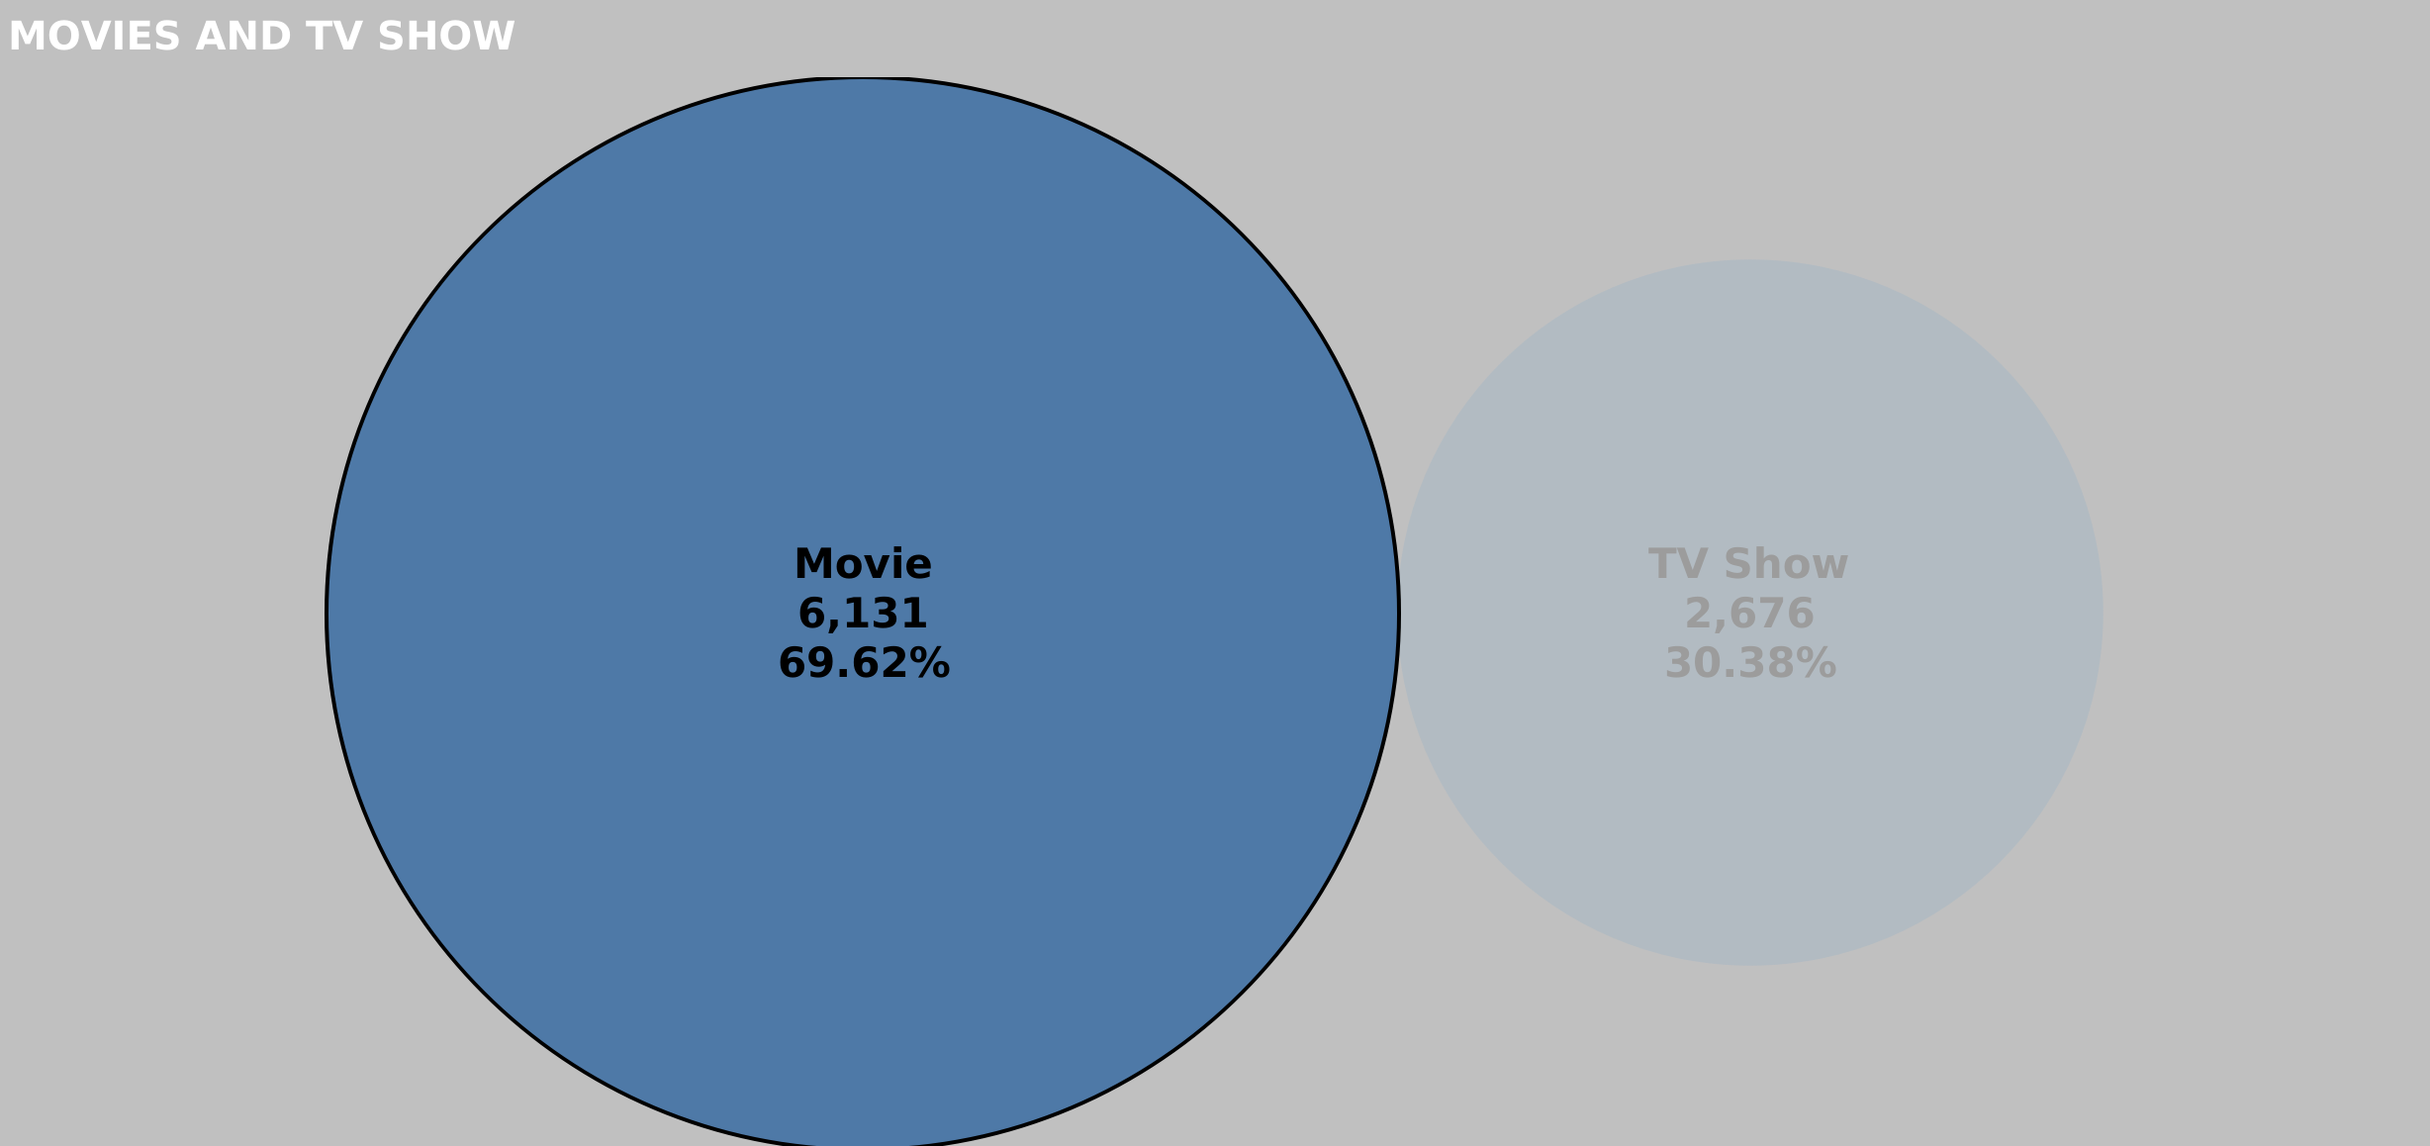
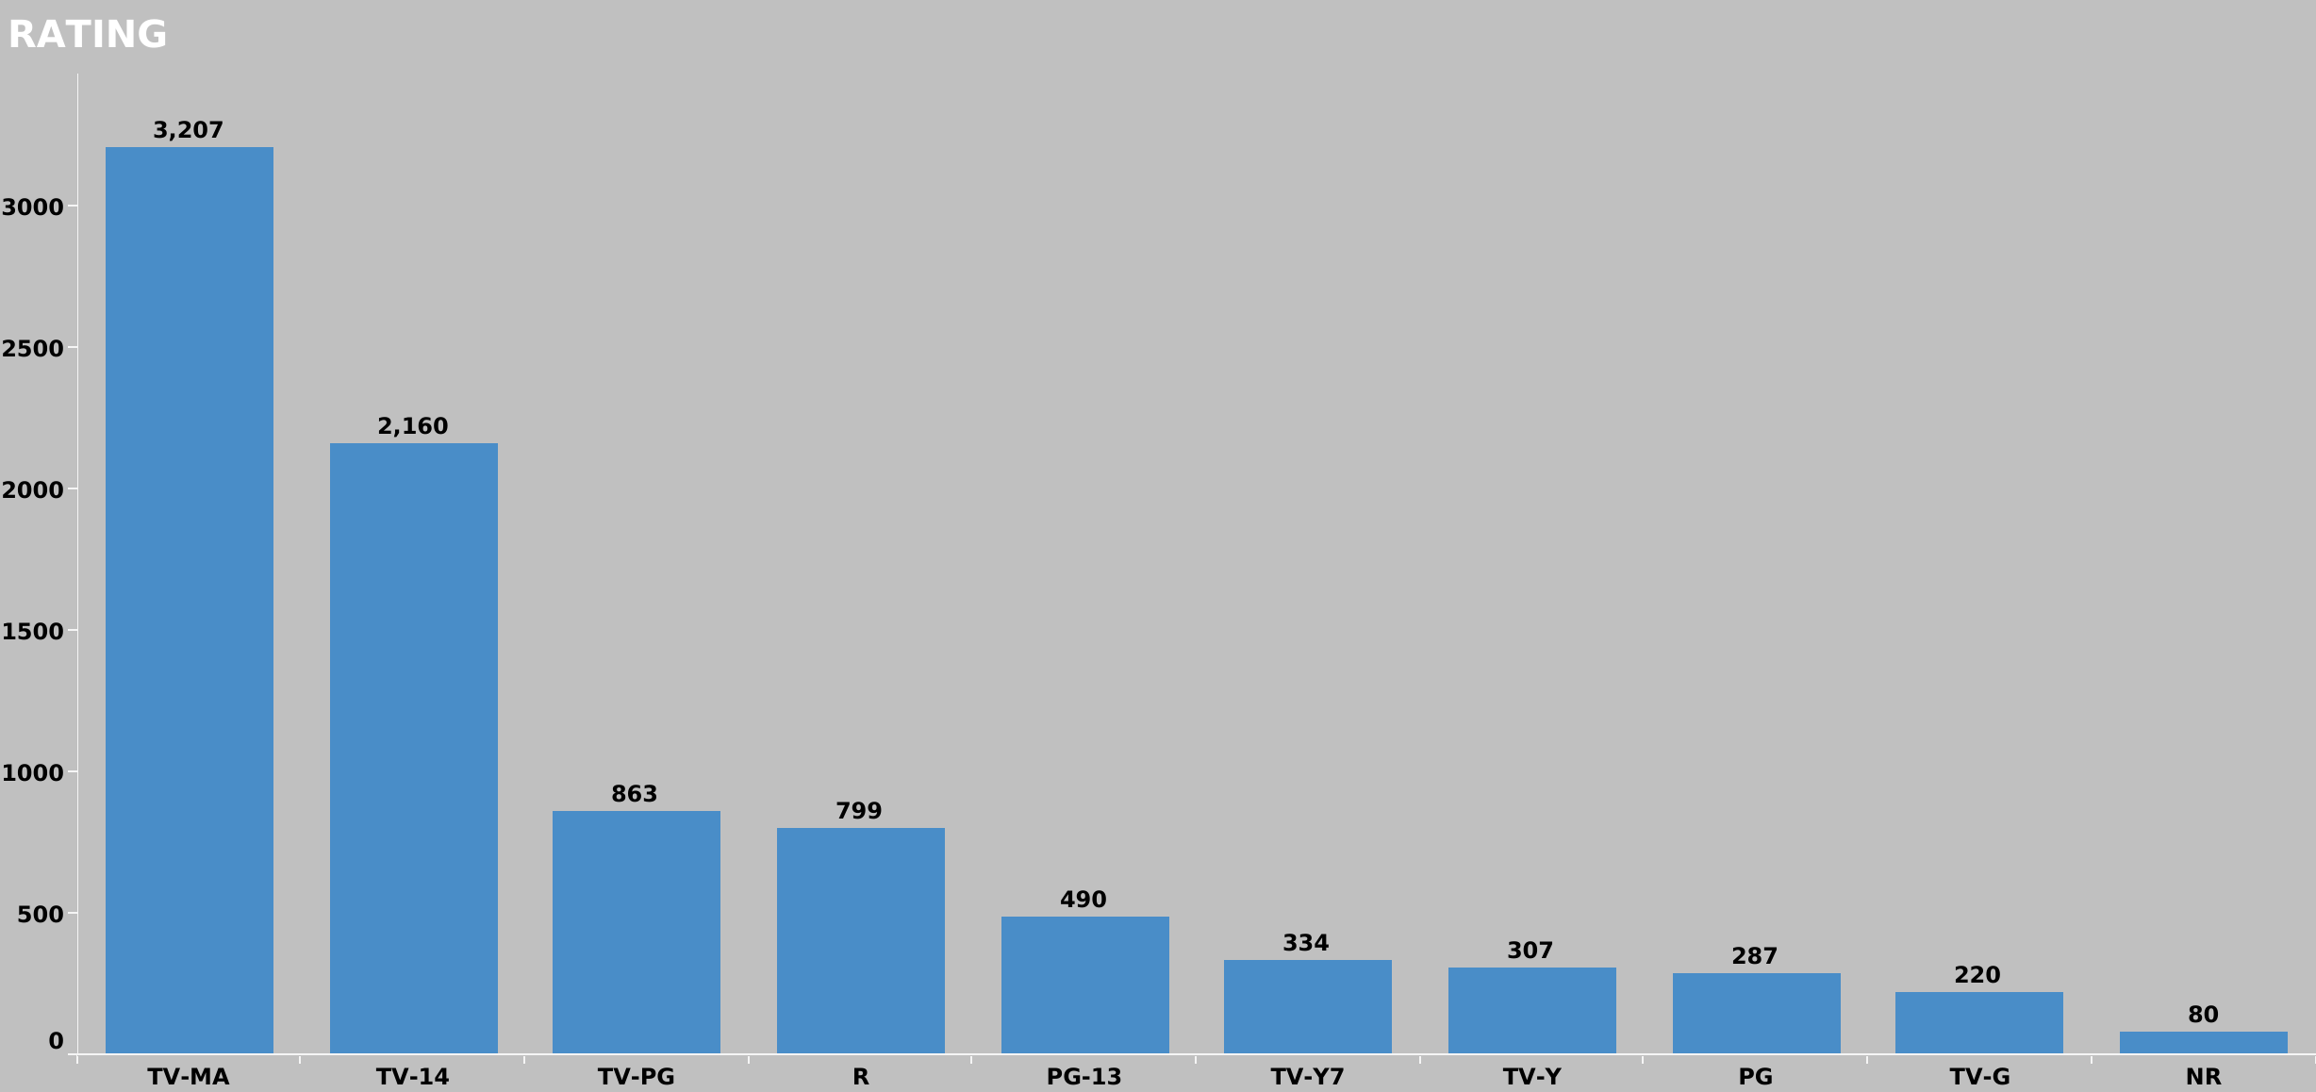
What if I prefer Movies?
Introduction
The graph implemented in the second dashboard shows the user the percentage and count of Films and TV Series highlighting the class with greater frequency.
Objectives
Data
Infographics
What if I want to deny content to my children?
Evaluation
In the second dashboard we have also implemented a graph capable of describing, depending on the type of filter applied, the percentages of the Ratings for each title belonging to that category of filters.
Survey
Conclusions

Slide 9
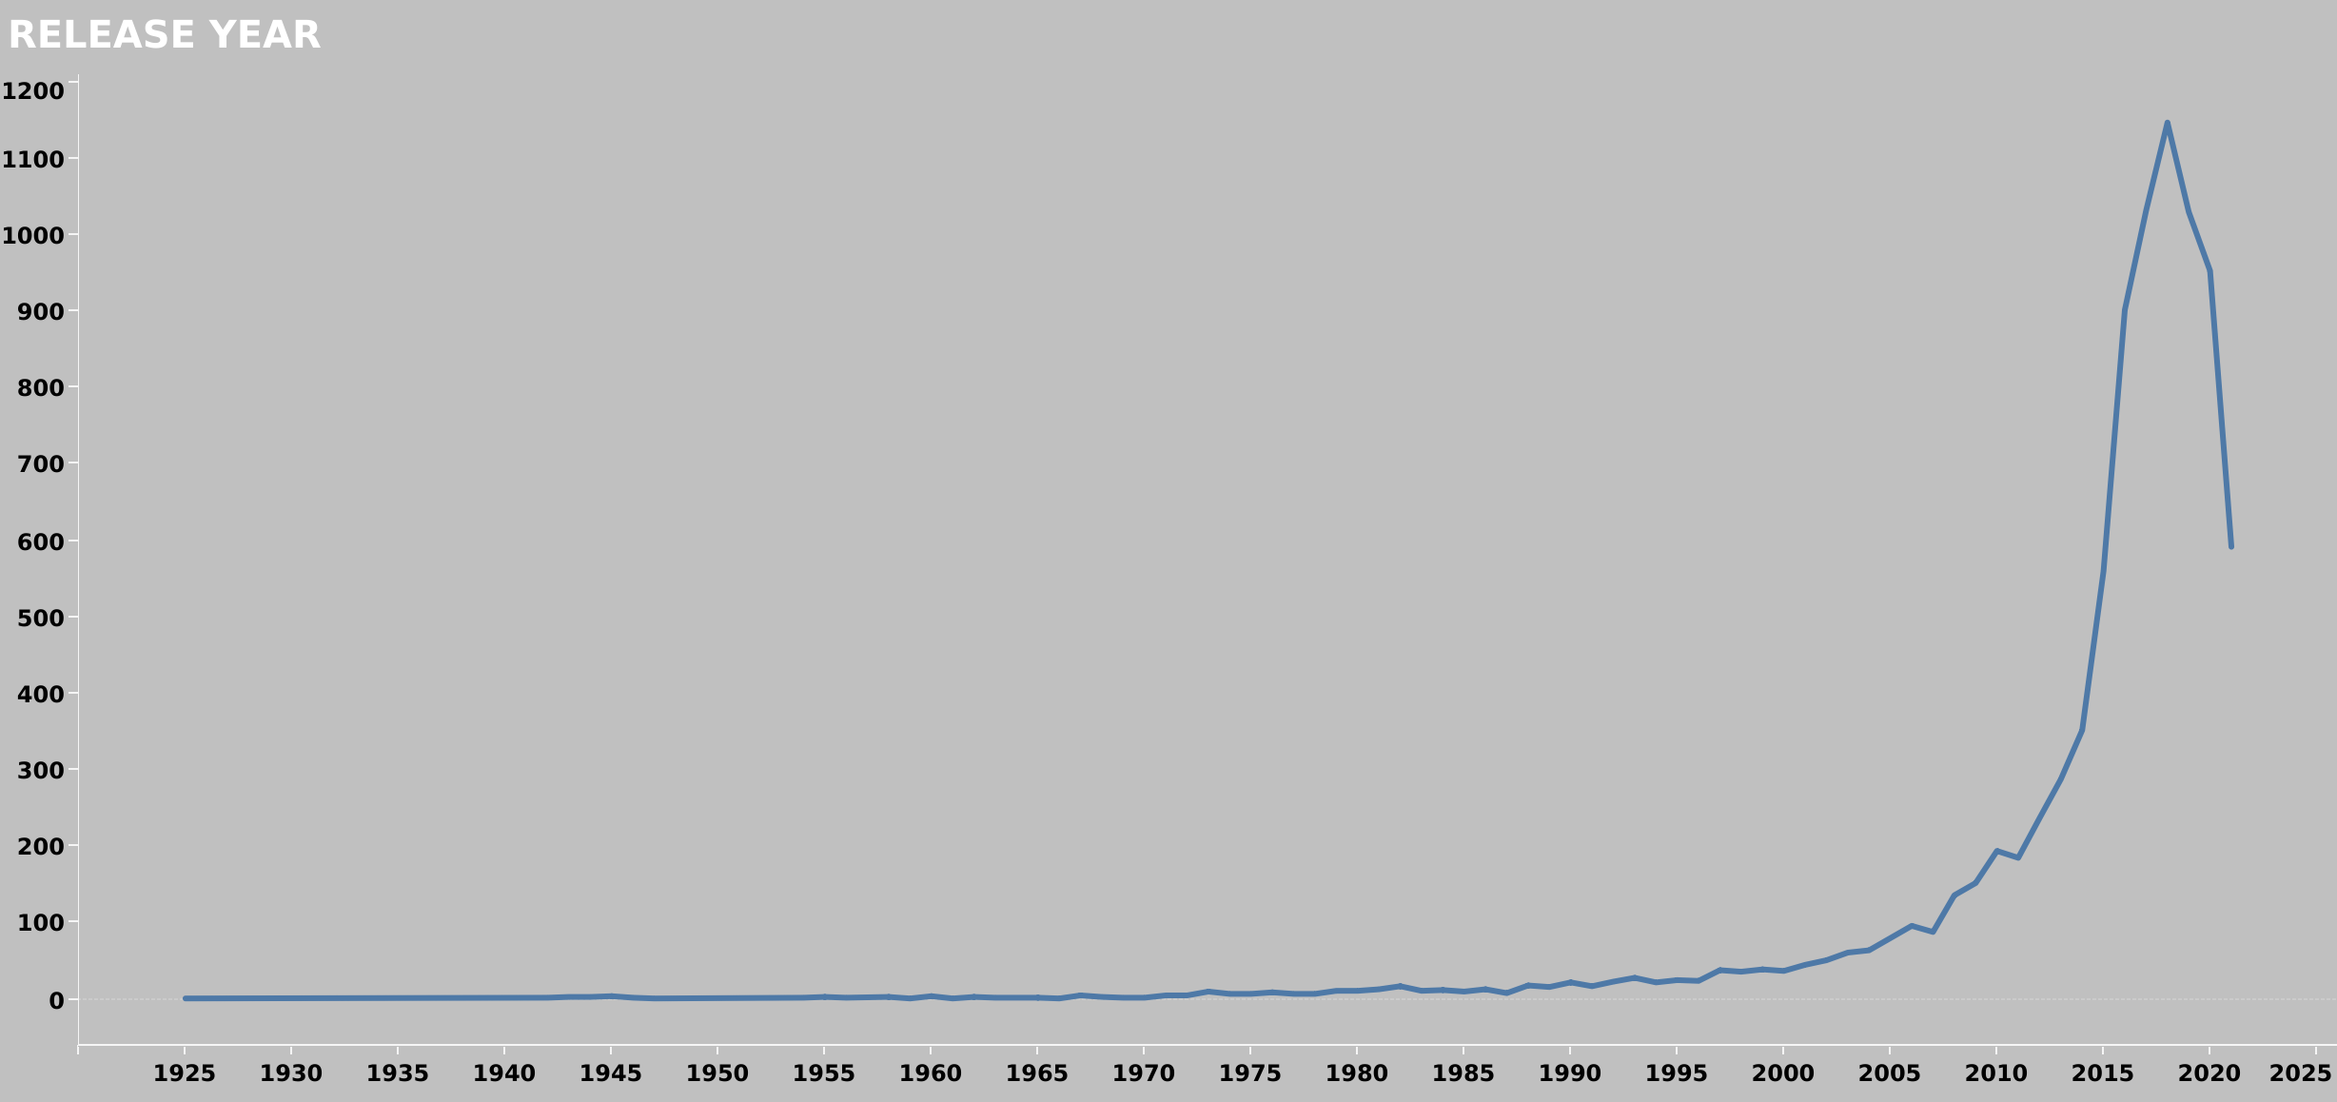
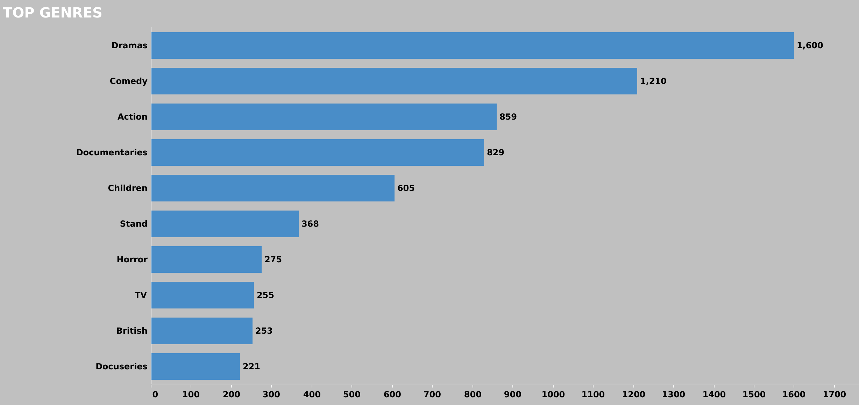
What if I prefer
Old Movies?
Introduction
Learn more about the release year of titles on each platform.
Objectives
Data
Infographics
What if I prefer Dramas rather than Docuseries?
Evaluation
Learn more about the majority of genres featured on each platform.
Survey
Conclusions

Slide 10
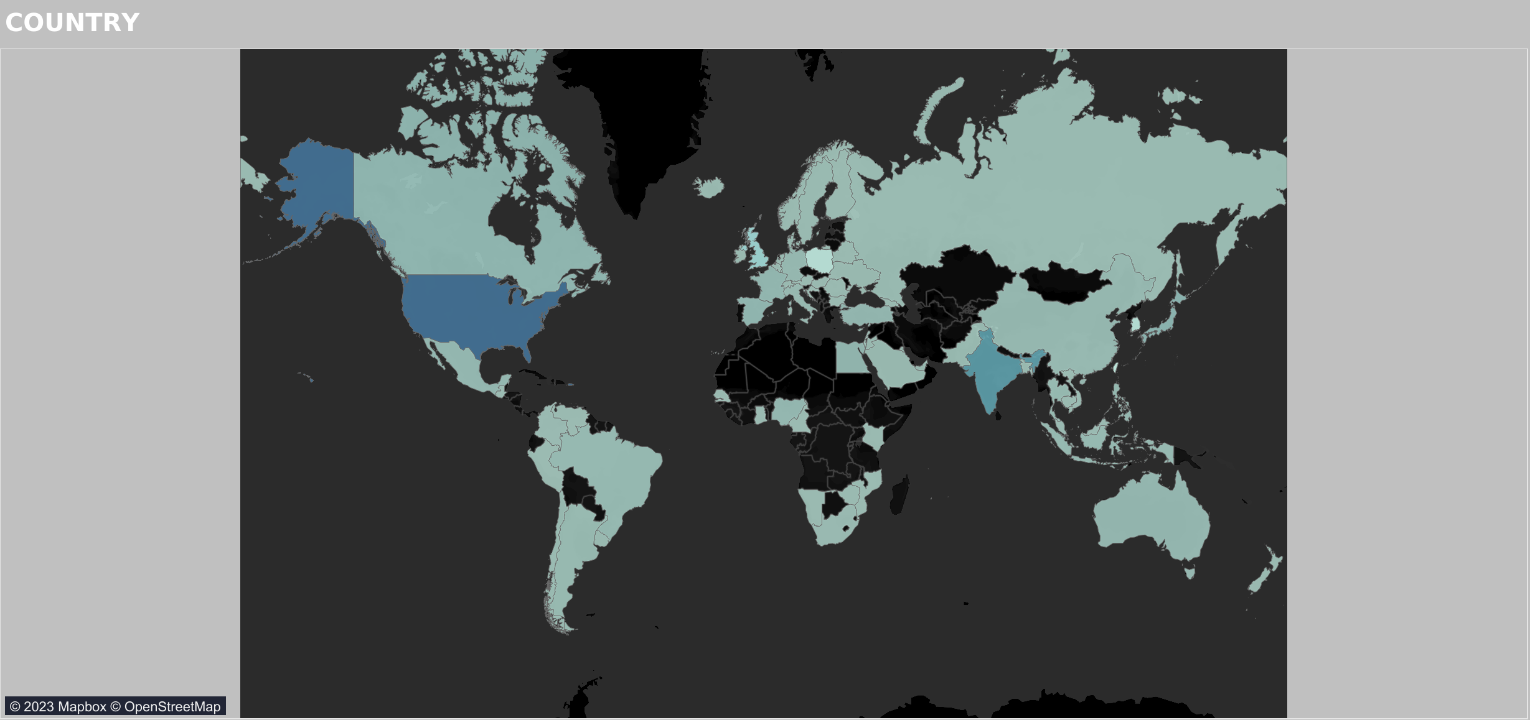
What if I prefer Italians Landscapes?
Introduction
A further graph has been implemented containing, for each platform, the count of titles by genre, highlighting its nationality on the map.
Objectives
Data
Infographics
Evaluation
Survey
Conclusions

Slide 11
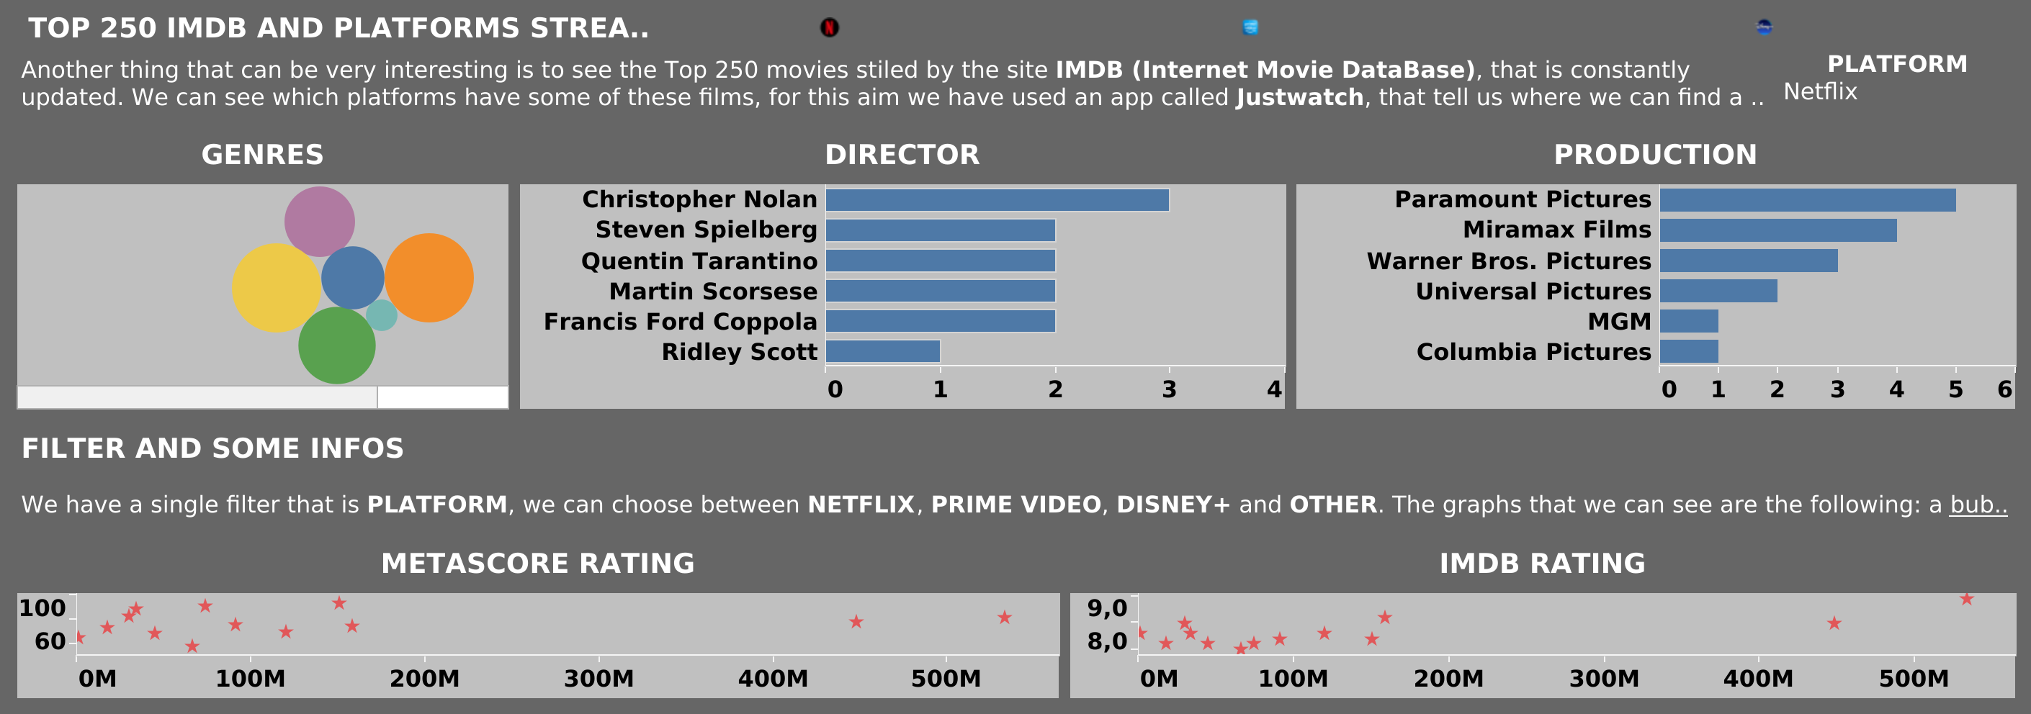
Accessable Here.
Third Dashboard
By collecting the following information in a third dashboard we have therefore provided the user with a great many selection criteria.
By providing interactive graphics, we were able to arouse their attention and give them a cue of curiosity and nostalgia for some titles.
Introduction
Objectives
Data
Infographics
Evaluation
Survey
Conclusions

Slide 12
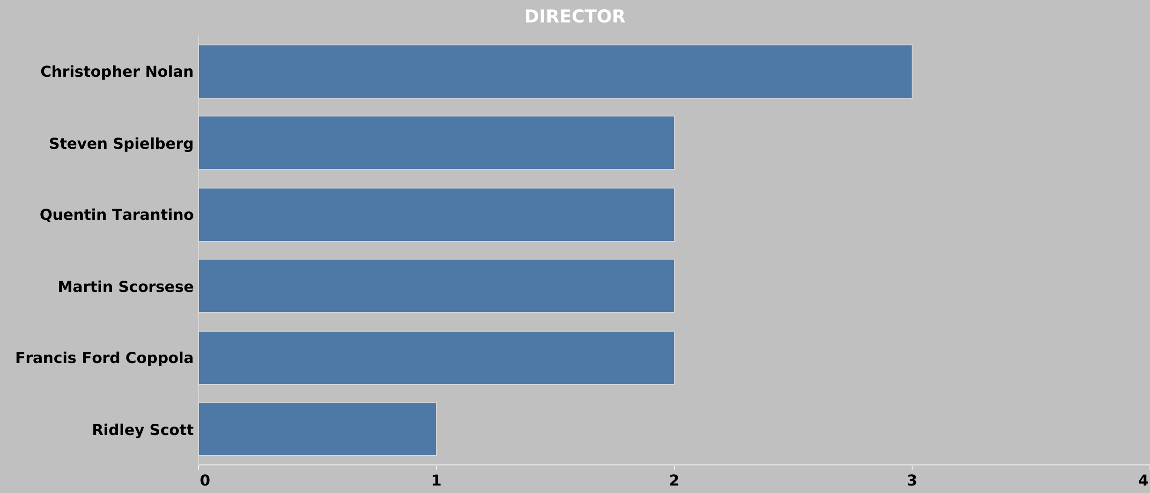
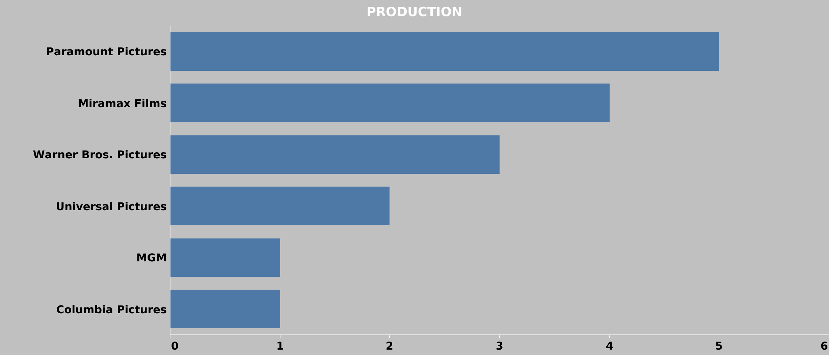
What if I prefer Americans Directors?
Introduction
Each of us has preferences with respect to one director over another. It therefore seemed appropriate to provide a further indicator regarding this aspect.
Objectives
Data
Infographics
What if I prefer Paramount Pictures?
Evaluation
Each of us has preferences with respect to a Production Company.
Each of us has the image of the Metro-Goldwyn-Mayer lion impressed in our minds
Survey
Conclusions

Slide 13
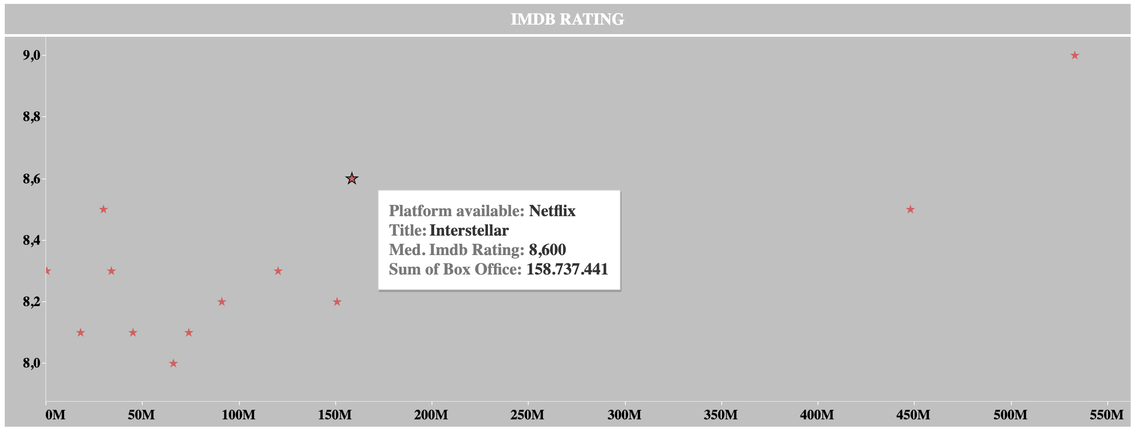

What about Ratings of Movies?
Introduction
It is therefore possible to have a lot of information about the most voted titles. Just select a vote in the graph to have access to the Platform on which the title is present, to the Title itself and to the IMDB Rating.
Objectives
Data
Infographics
Evaluation
Survey
Conclusions

Slide 14

Final Changes
Accordingly to user’s opinions after Test, we tried to improve the aesthetic profile and we made the final changes:
Introduction
Objectives
Data
The possibility, at the request of users, to be able to filter the titles according to the duration in order to have a reference based on the time available to watch a title.
Infographics
Evaluation
The division of dashboards by TV Shows and Movies in order to get dashboards more understandable.
Survey
Conclusions

Slide 15
Your Subscription:
Introduction
Objectives
Data
Netflix
Amazon Prime Video
Disney+
Infographics
It is the most suitable platform for those looking for a wider catalog and proportionally more TV series, although the cost of the subscription is higher.
It is the platform that focuses more on arthouse films which, in fact, presents more titles awarded by the Top 250 compiled by IMDb.
It is the platform in which there are more Classic and Animation films, but also the one with fewer titles in the catalog among the three platforms.
Evaluation
Survey
Conclusions

Slide 16

Introduction
Objectives
Data
Thanks for your Attention.
Infographics
Evaluation
Survey
Conclusions

Slide 17
Sources:
Dataset Netflix: https://www.kaggle.com/datasets/shivamb/netflix- shows
Dataset Disney+: https://www.kaggle.com/datasets/shivamb/disney- movies-and-tv-shows
Dataset Amazon Prime Video: https://www.kaggle.com/datasets/shivamb/amazon- prime-movies-and-tv-shows
Dataset IMDb: https://www.kaggle.com/datasets/yehorkorzh/imdb- top-250-movies
Further informations are collected from JustWatch: https://www.justwatch.com
Introduction
Objectives
Data
Infographics
Evaluation
Survey
Conclusions

